Slide 1
Project Enhanced Audio Recognition
Joshuan Jimenez
July 24, 2019

Slide 2
Outline
Background Information
Timeline
Cost
Problem
Solutions
Summary

Slide 3
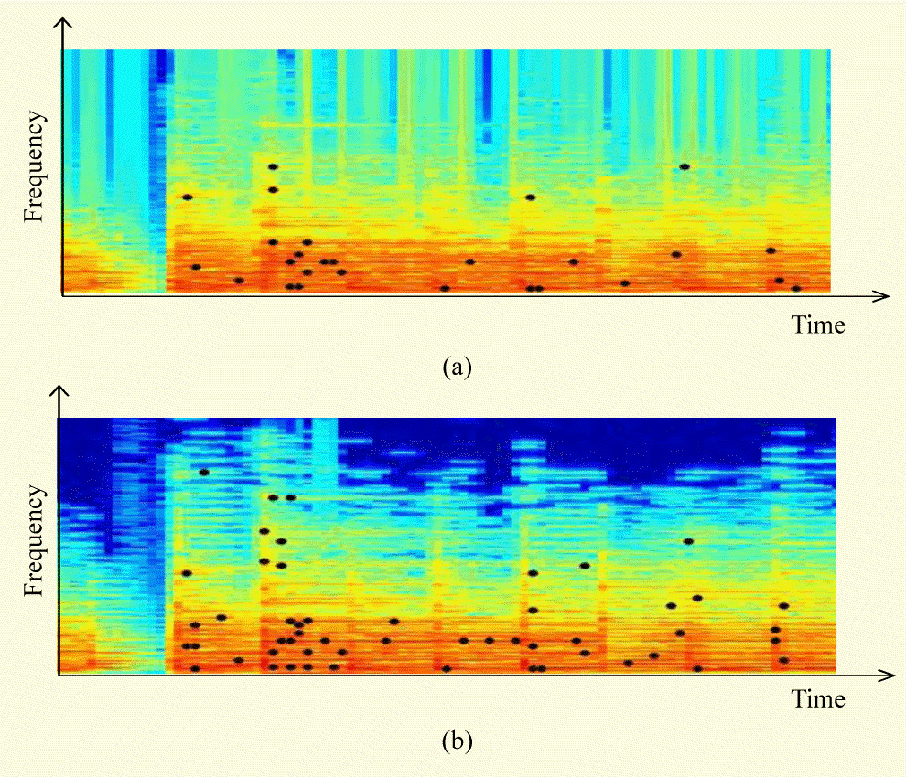
Background
Inspired by Shazam and Akinator
Humming for audio input to create audio fingerprint
Branching Questions for User
Finds desired song

Slide 4
Timeline
 | Description of Work | Start and End Dates
Phase One | Planning and Design | August 1st 2019 – August 15th 2019
Phase Two | Coding, Development, and Testing | August 16th 2019 – November 16th 2019
Phase Three | Release, Marketing, and Live Testing | November 16th 2019 – February 16th 2020

Slide 5
Cost
Wages and Salaries
Software Engineer (Joshuan Jimenez) | $40,000
Software Developer (Randy Rivas) Subtotal | $40,000 $80,000
Advertisement during Phase 3 (3 months)
Social Media (Twitter, Instagram, Facebook) | $1,000
TV Advertisement Subtotal | $1,000 $2,000
Total | $82,000

Slide 6
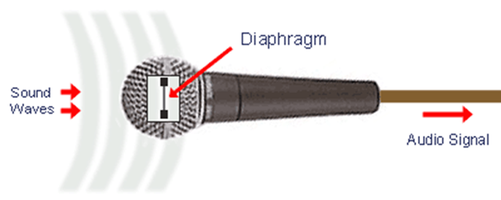
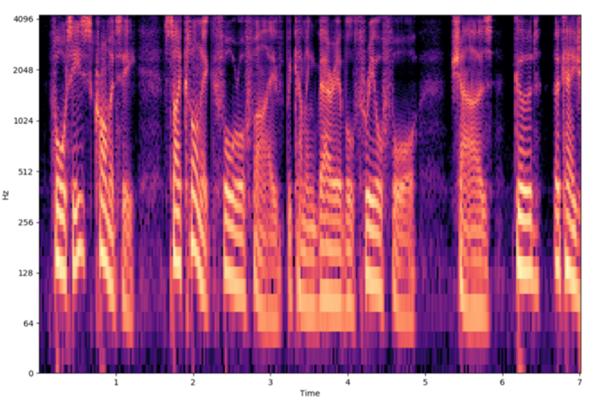
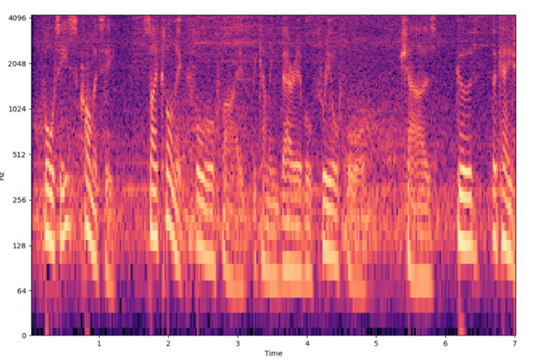
Problem
If Working
If Not Working
Clean Audio Fingerprint
Dirty Audio Fingerprint

Slide 7
Solutions
Develop algorithm to automatically clean
Develop algorithm to adjust mic sensitivity
Combine both ideas into one

Slide 8
Summary
Application to find song using humming and questioning
Time frame of 6 and a half months
Costs around $82,000
Had an issue with input being dirty
Fixed by developing algorithm to clean input

